Slide 1

1

Slide 2
2
Cleckhuddersfax
e-Commerce Website That Consists Of 5 Vendors

Slide 3
3
PRESENTING TIME
A TOTAL OF 25 MINUTES HAS BEEN ALLOCATED
Swastika Adhikari
Utsav Sapkota
5 Minutes
5 Minutes
Sujan Pariyar
Prashanna Shrestha
5 Minutes
5 Minutes
Sakriya Bajracharya
5 Minutes

Slide 4
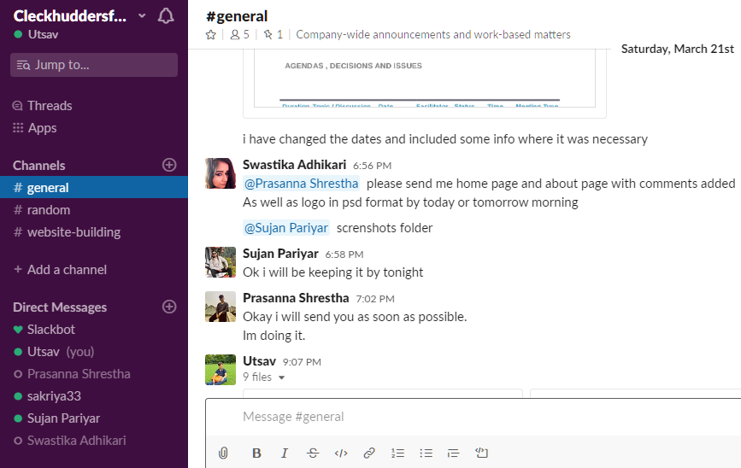
Communication & Collaboration Tools
4
1
Slack (Android/IOS app for instant communication and update)
2
MS Project for project management and monitoring

Slide 5
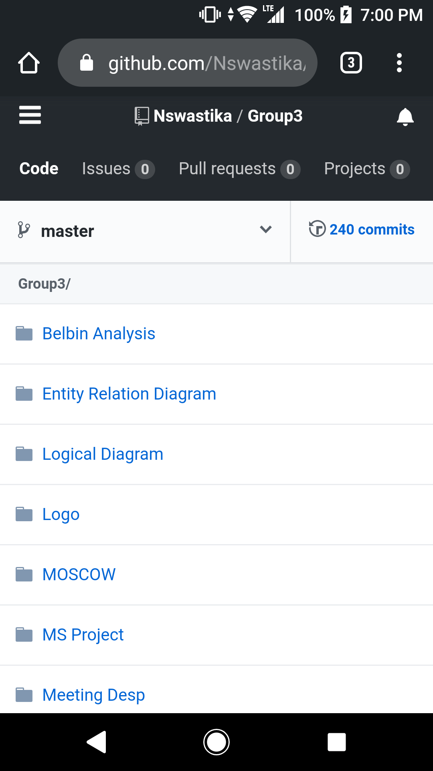
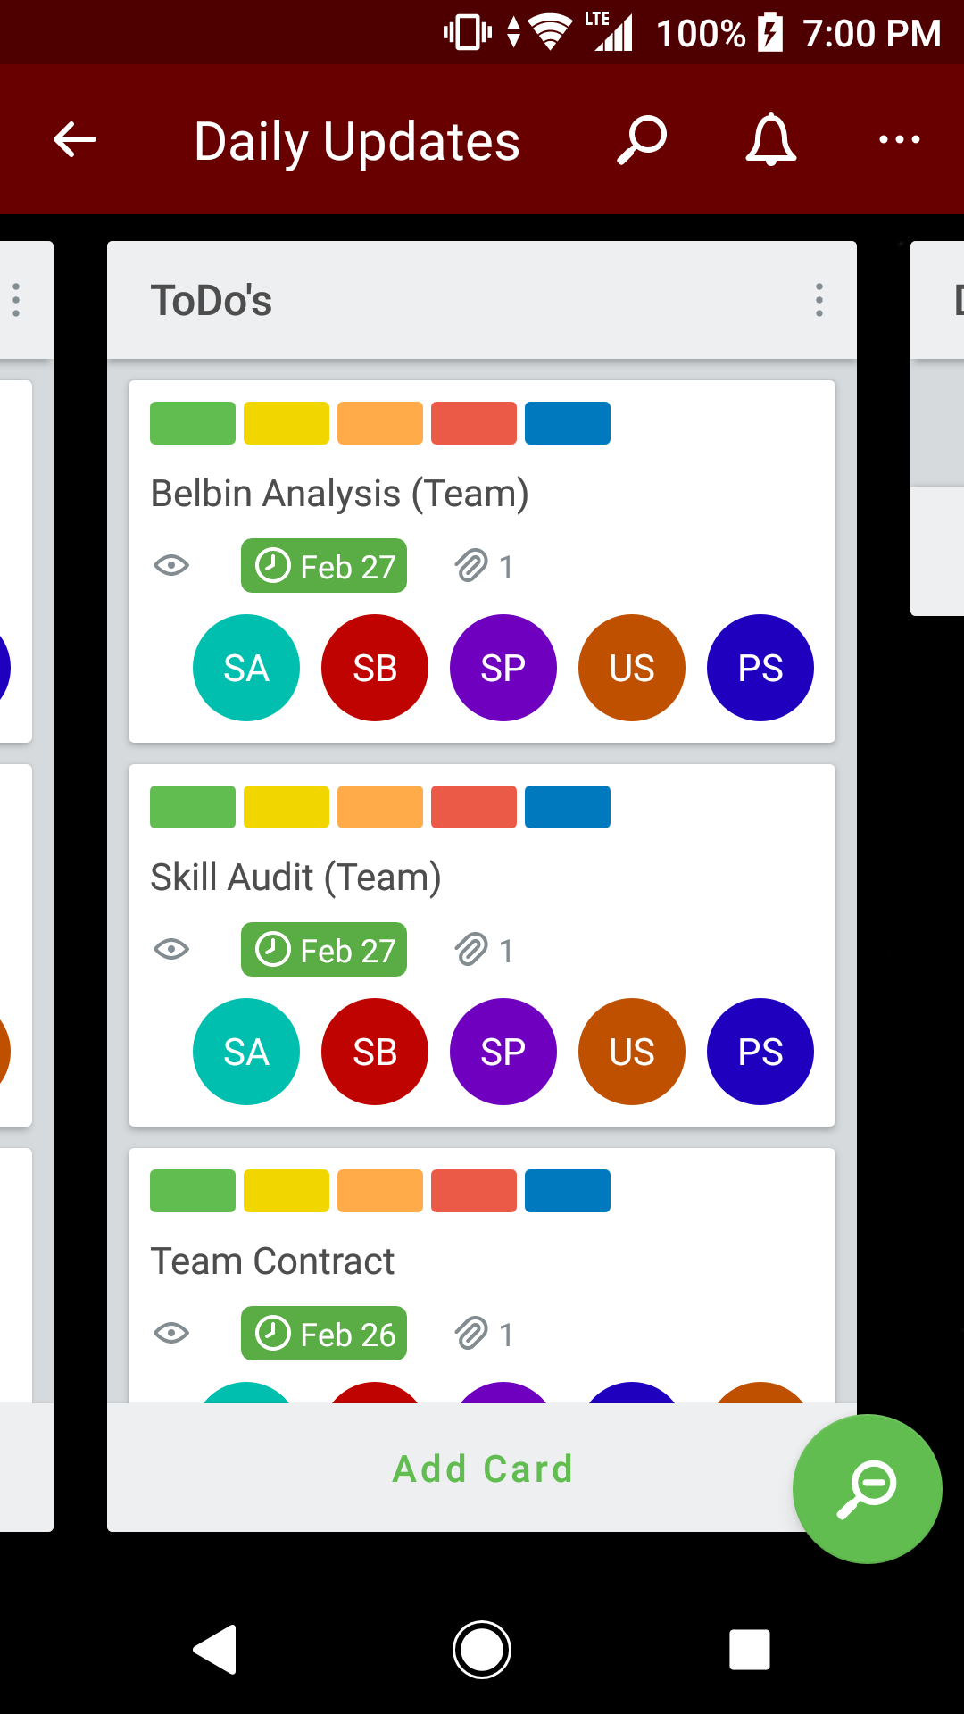
For Task Segregation & Storage
5
&
3
GitHub to store our work
4
Trello for task scheduling

Slide 6
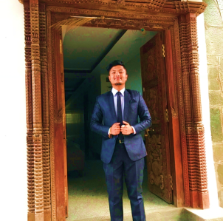

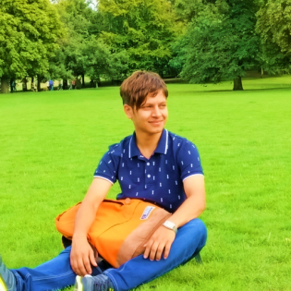
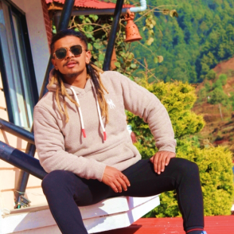
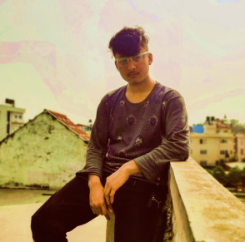
OUR TEAM
6
Sakriya Bajracharya
Complete Finisher / Specialist / Co-ordinator
PROJECT MANAGER
SIR ROHIT RAJ PANDEY
PROJECT CUSTOMER
Citizens of Cleckhuddersfax
PROJECT SPONSOR
The British College, Thapathali, Kathmandu
Utsav Sapkota
Plant / Team Worker / Monitor Evaluator
Sujan Pariyar
Monitor Evaluator / Shaper / Co-ordinator
Swastika Adhikari
Prasanna Shrestha
Implementer / Resource Investigator / Specialist
Resource Investigator / Shaper / Team Worker

Slide 7
7
PROJECT CHARTER

Slide 8
Project Title: Cleckhuddersfax E-Convenient Store Project Sponsor: The British College, Thapathali, Kathmandu Project Manager: Rohit Pandey Sir Team Leader: Swastika Adhikari Date amended: 2020-06-10 Project Customer: Citizens of Cleckhuddersfax
8
Version | Date | Summary of changes
1 | 2020-02-23 | Initial project All the vital things have been done for future scope.
2 | 2020-06-10 | Duration and estimated budget have been updated. Gmail is added as a collaboration tool and one drive is removed.
A group of traders of Cleckhuddersfax are intending to build up an internet business site i.e. ecommerce website. The business website is being created to help and inspire local traders to compete against the larger supermarket and convenience stores. Their aim is to provide an advantage to the trader with a new emerging technology which appears to be useful for both trader and customer. They are planning to provide a great chance to customers to order and purchase things in a relatively brief period of time from the ease of their comfort zone. This ecommerce platform incorporates all five traders: butchers, greengrocer, fishmonger, bakery and delicatessen within the Cleckhuddersfax area in UK. This ecommerce platform provides an ideal space for all types of traders to show the best of their self on the internet to grab the attention of their target customers and beat the heated competition. This platform helps the local trader to grow as well as benefit the client in the certain area. The website helps to promote the local tradition of area as well as help the local traders to compete against the bigger businesses like supermarket and stores without losing their valuable times for their family and friends. This website has three interfaces. One for customer, one for traders and one for management (admin). An admin login can access any of trader accounts. Every five trades have different login credentials which help them to access their database. Trader can also view everyday report and update the details of their trader account. Trader will be provided with weekly finance report of all the orders that are delivered only. This website will have cart functionality where customer will get an option to add favourite products to cart. The payment method is a PayPal which is convenience and more secure way to pay online. The site will assist the customer to shop easily without worrying about running out of products. They don’t need to physically move around and waste valuable time to buy one specific product. This ecommerce website provides convenience to buy goods or services without causing any physical restrictions to the costumers and even helps to save money as well as precious time.

Slide 9
Objectives Attract local people who cannot shop during a normal opening hour to order and purchase things in a brief period of time. Help the local traders to compete against the bigger business without losing their family time. Promote the local tradition of area. Introduce the customers to high quality limited as well as unique products and fresh goods. Expand trade by adding more traders within a group. Three days a week to collect the products ordered. Provide a wonderful opportunity to customers to browse and buy products from the ease of the comfort zone. Eliminate the travel time and cost for customers. Create simple user interface to understand by all types of user, trader and accessible through web interface and most popular browsers.
Customer Interface Select the products from 5 traders in the initial phase. Sort the products by shop or by product type. Capture the heritage of the Cleckhuddersfax area. Interface viewable on all major browsers and will be compatible in both mobile and desktop view. A cart function that can hold the products from all the traders. Registration system in order to place an order. Login system in order to access their basket/cart by customers. Review and update customer account details. Confirm the changes made in customer registration and account update through the emails that they used for registration. Pick up the orders in three slots in three different days i.e. 10-13, 13-16, 16-19 in the days Wednesday, Thursday and Friday. Place the orders 24 hours before the desired pickup time and day. PayPal function for the payment. Trader Interface Manage product and information. Able to add, delete and update product through trader account. When a Trader adds a product, the product will have a Unique ID, Short Name, Description, Item Price, Min Order, Max Order, allergy Information which must be added by the Trader. Login the Database using trader account that shows the reports of the available stock and report of orders. Unique login Credentials of every trader which shows their details only. Admin login that can access the whole system. Management Interface Dashboard that has a range of daily and periodic reports. Daily report on the orders placed that contain the products and quantities which has been ordered and also shows which delivery slots are used. Weekly finance report which shows the number of products that is sold along with the payment for the last 7 days which will only include the orders that have been delivered. Access all the trader accounts. Monthly report of the product sales which can be sorted alphabetically; total numbers of orders per products or total income per product
9
Project Scope

Slide 10
MAJOR DELIVERABLES E-Commerce website with customer, trader and management interface. Management interface connected with database. Registration system to place an order by customer. Single basket to add products from different traders. Login system to access the cart. Website supporting a maximum of ten shops for initial pilot project. Traders’ interface that allows add/delete/update products on their corresponding shops. Responsive design viewable on mobile as well as desktop devices and viewable on the most popular browsers. User-friendly navigation of products by shop or product type for customers. An admin login for management interface that can access any of the trader accounts. A maximum of 20 orders per slot for 3 collection slots 10:00-13:00, 13:00-16:00, 16:00-19:00 on Wednesdays, Thursdays and Fridays which must be at least 24 hours after placing the order. PayPal is used for online payment which is secure.
10
DURATION Initial prototype Presentation - 2020-03-24 Deployment for testing - 2020-06-18
ESTIMATED BUDGET Hours per day per person: 3 – 4 hours Hours per week per person: 18 – 24 hours Team of 5 members Hence the total hours till 16th week: 18*5*16 = 1440 hours max: 24* 5* 16 = 1920 hours

Slide 11
Name | Role
Prasanna Shrestha | Resource Investigator / Shaper / Team Worker
Sakriya Bajracharya | Complete Finisher / Specialist / Co-ordinator
Sujan Pariyar | Monitor Evaluator / Co-ordinator/ Shaper
Swastika Adhikari | Implementer / Resource Investigator / Specialist
Utsav Sapkota | Plant / Team Worker / Monitor Evaluator
11
Communication and Collaboration Tools Communication - As a team we will be communicating using slack. The workplace of slack allows us to organize communications and share information, files and more all in one place. It also have most powerful feature i.e. integration with third party services. The integration we will use to share our files with our team members is GitHub. Using GitHub it is easier to collaborate with team members so we will be using it as a repository. Team Meetings - Face-to-face meeting with team members will be held twice a week i.e. every Monday and Thursday at 8:40 am. Face-to-face meetings allow for clearer communication and often end up being more positive and more credible than online conversations. Documentation – Gmail will be used to share the documentations generated on the project. Project Tracking – Trello will be used to track the progress of the project.

Slide 12
Vendors List
12
Butchers
Greengrocers
Fishmongers
Bakery
Delicatessen

Slide 13
13
“
Quality is the best business plan
”
Cleckhuddersfax

Slide 14
Team Net Risk Register
14
R
Red | Catastrophic
Green | Insignificant
I
Amber | Moderate
S
K

Slide 15
15
CLECKHUDDERSFAX E-CONVENIENT STORE RISK REGISTER
Description |  |  |  |  | Measures |  |  |  |  |  | Status and review
Risk ID Code | Risk | Risk Description | Risk Owner | Strategic Plan Theme | Gross risk (pre-controls) |  | Control Measures Employed | Net Risk (post-controls) |  | Comments / Further Actions Required / Contingency Plan - including deadline dates | Last Review Date | Next Review Date | Current Status | Overall indicator
 |  |  |  |  | Likelihood (1,2,3,4,5) | Impact (1,2,3,4,5) |  | Likelihood (1,2,3,4,5) | Impact (1,2,3,4,5)
2.1 | Technical | Unable to master php, front-end and apex oracle programming | Swastika Adhikari, Prasanna ShresthaSakriya Bajracharya, Utsav Sapkota, Sujan Pariyar | N/A | 3 | 4 | Woking through vidoes and tutorials, discussing with collegues | 2 | 4 | Ask for support if problem arises in understanding | 10/04/2020 | 8/6/2020 | Reducing | ↓Amber
2.1 | Technical | Slow network problem and battery problem | Swastika Adhikari | N/A | 3 | 5 | N/A | 3 | 4 | Seek support | 01/05/2020 | 8/6/2020 | Unchanged
3.1 | Org | Required to work on other projects | Prasanna ShresthaSakriya Bajracharya, Utsav Sapkota, Swastika Adhikari, Sujan Pariyar | N/A | 2 | 2 | Conduct meeting through google meet every week | 1 | 2 | Work on project alternatively | 10/05/2020 | 8/6/2020 | Reducing
4.1 | PM | Less face-to-face communication between team members | Prasanna ShresthaSakriya Bajracharya, Utsav Sapkota, Swastika Adhikari, Sujan Pariya | N/A | 1 | 2 | Video calls and communication for discussions | 1 | 1 | Calls and commucation including chats | 10/05/2020 | 8/6/2020 | Closed | XGreen
4.1 | PM | Underestimated time required for project | Prasanna ShresthaSakriya Bajracharya, Utsav Sapkota, Sujan Pariyar | N/A | 3 | 3 | Estimated, shared and validated by supervisor | 2 | 3 | Review progress regularly | 25/04/2020 | 10/6/2020 | Reducing | ↓Green
5.1 | Natural | Mental and physical stress from covid-19 | Swastika Adhikari, Prasanna ShresthaSakriya Bajracharya, Utsav Sapkota, Sujan Pariyar | N/A | 5 | 5 | Use online mediums to conduct meetings and work from home | 5 | 5 | Switch to full online strategies | 15/03/2020 | 10/6/2020 | Increasing

Slide 16
16
DIAGRAMS

Slide 17
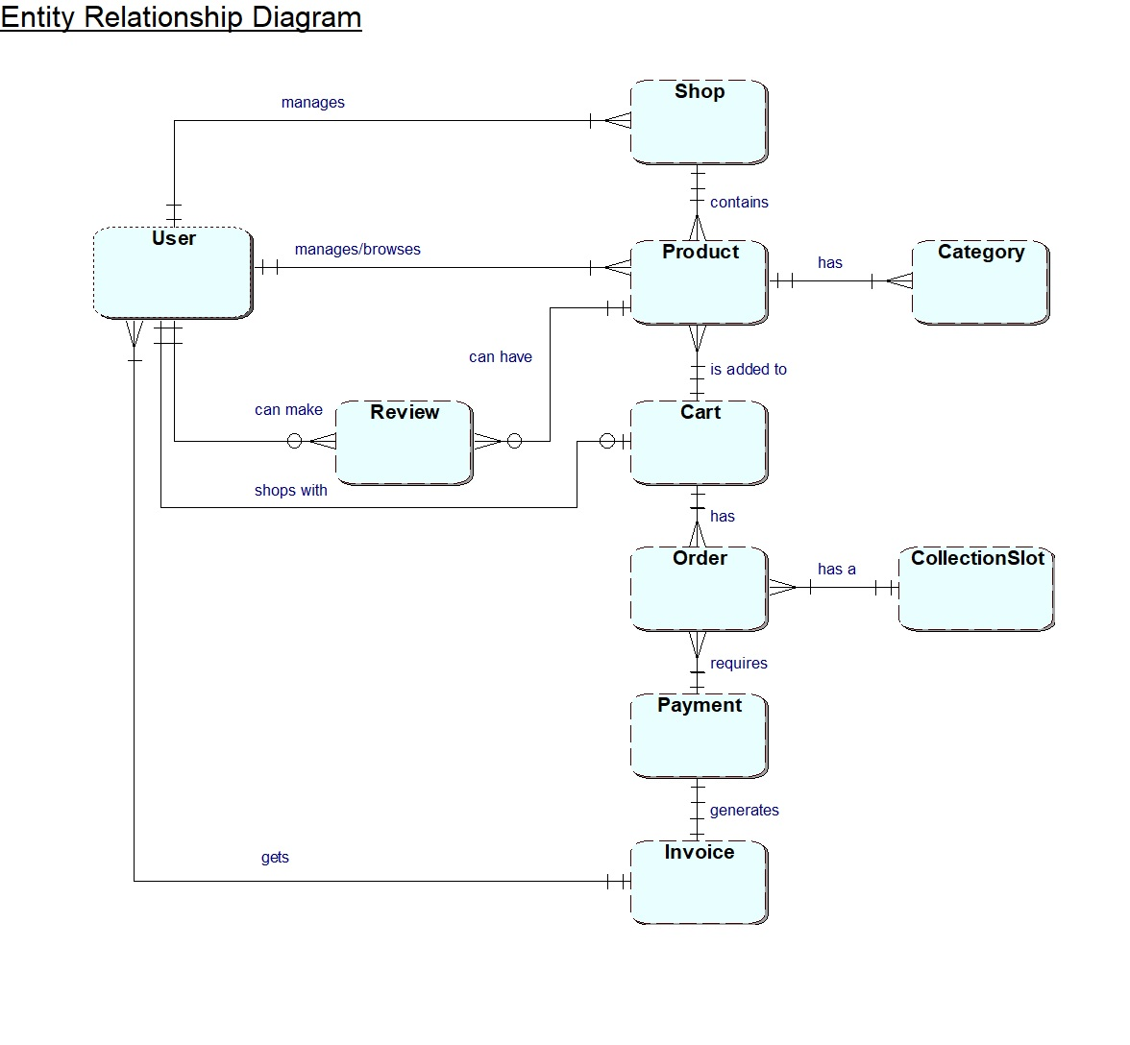
ERD
17

Slide 18
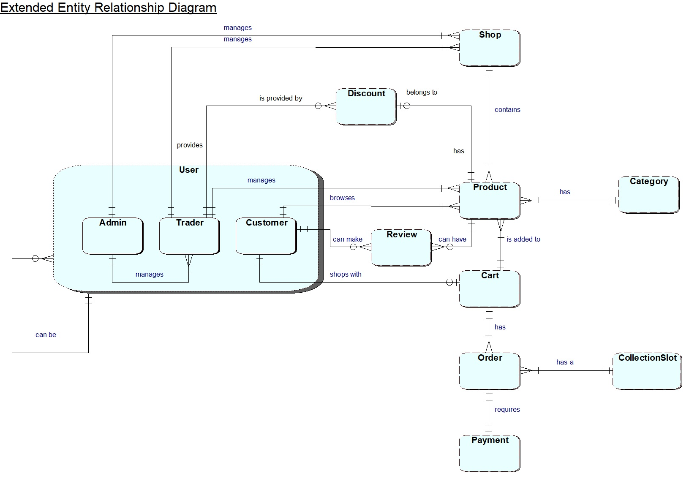
EERD
18

Slide 19
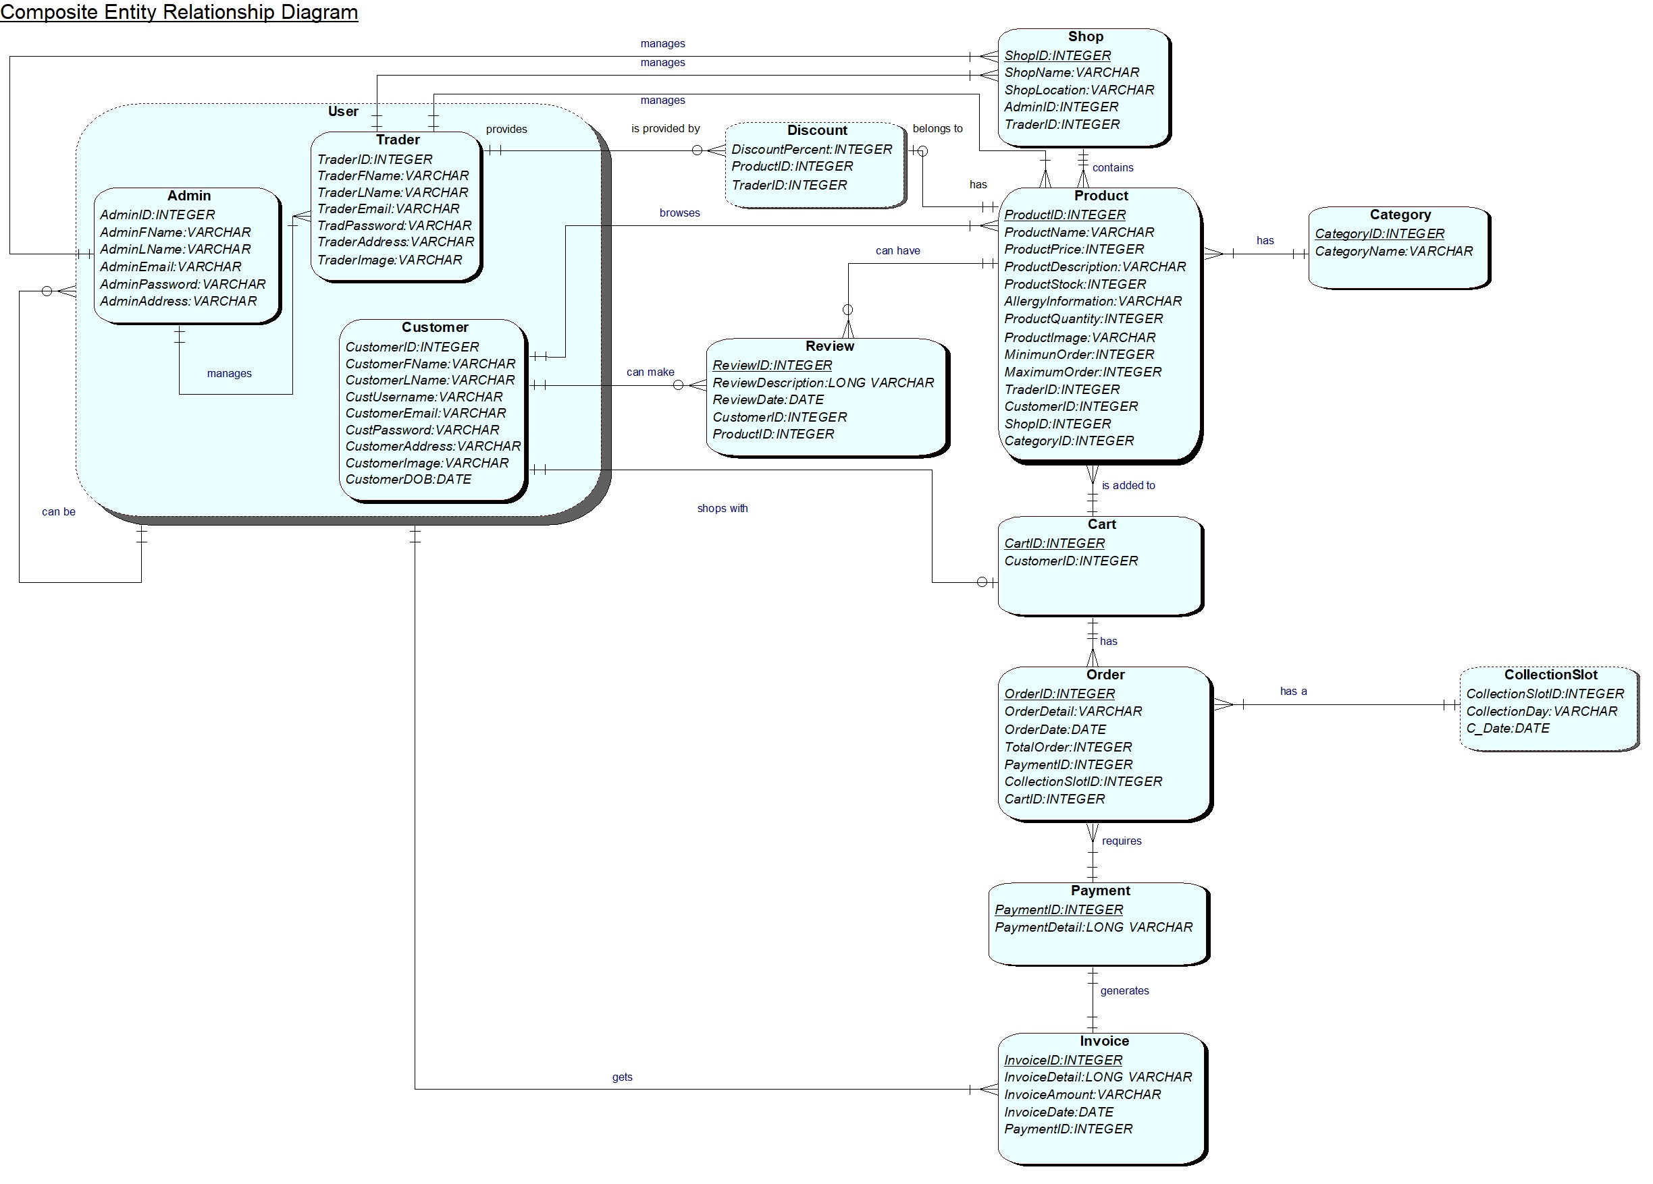
COMPOSITE ERD
19

Slide 20
20
USE CASE

Slide 21
Customer
21

Slide 22
Trader
22

Slide 23
Admin
23

Slide 24
OVERVIEW USE CASE DIAGRAM
24

Slide 25
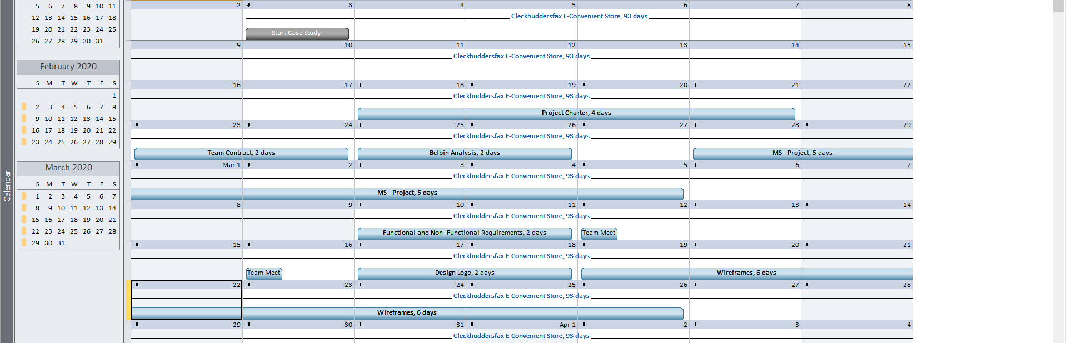
CALENDAR
25

Slide 26
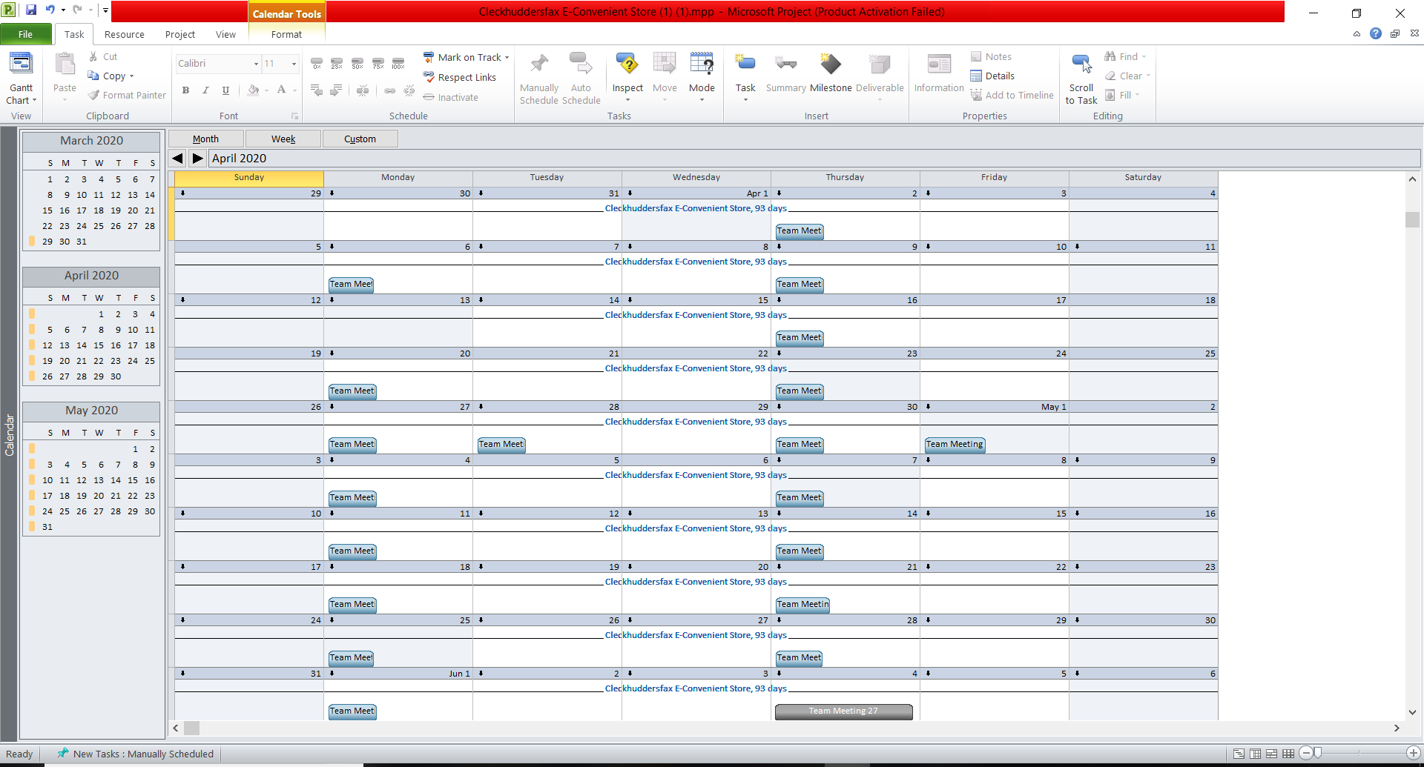
CALENDAR
26

Slide 27
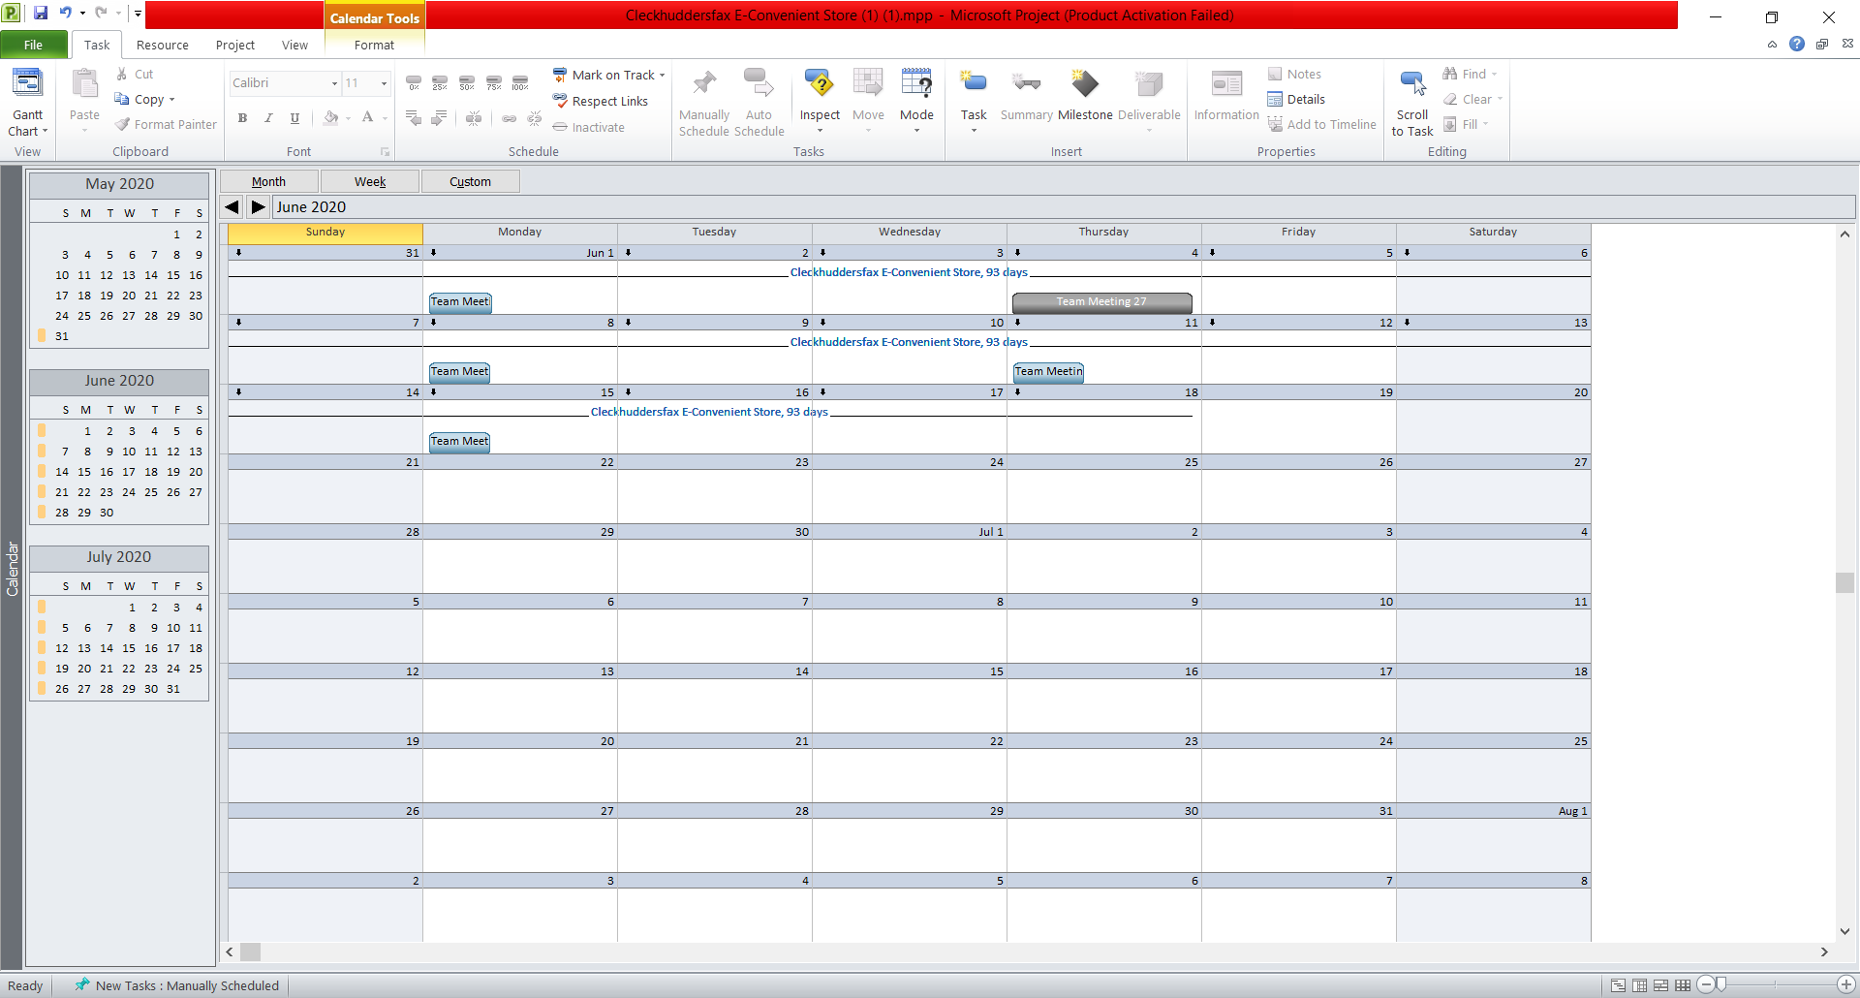
CALENDAR
27

Slide 28
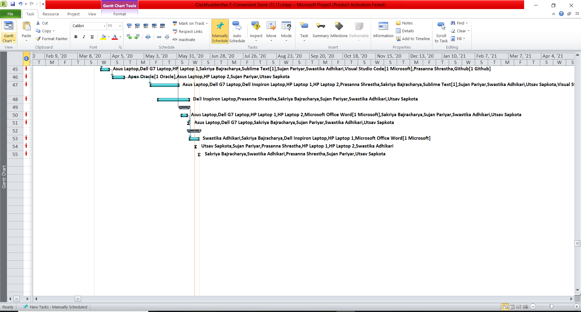
28
GANTT CHART SAMPLES

Slide 29
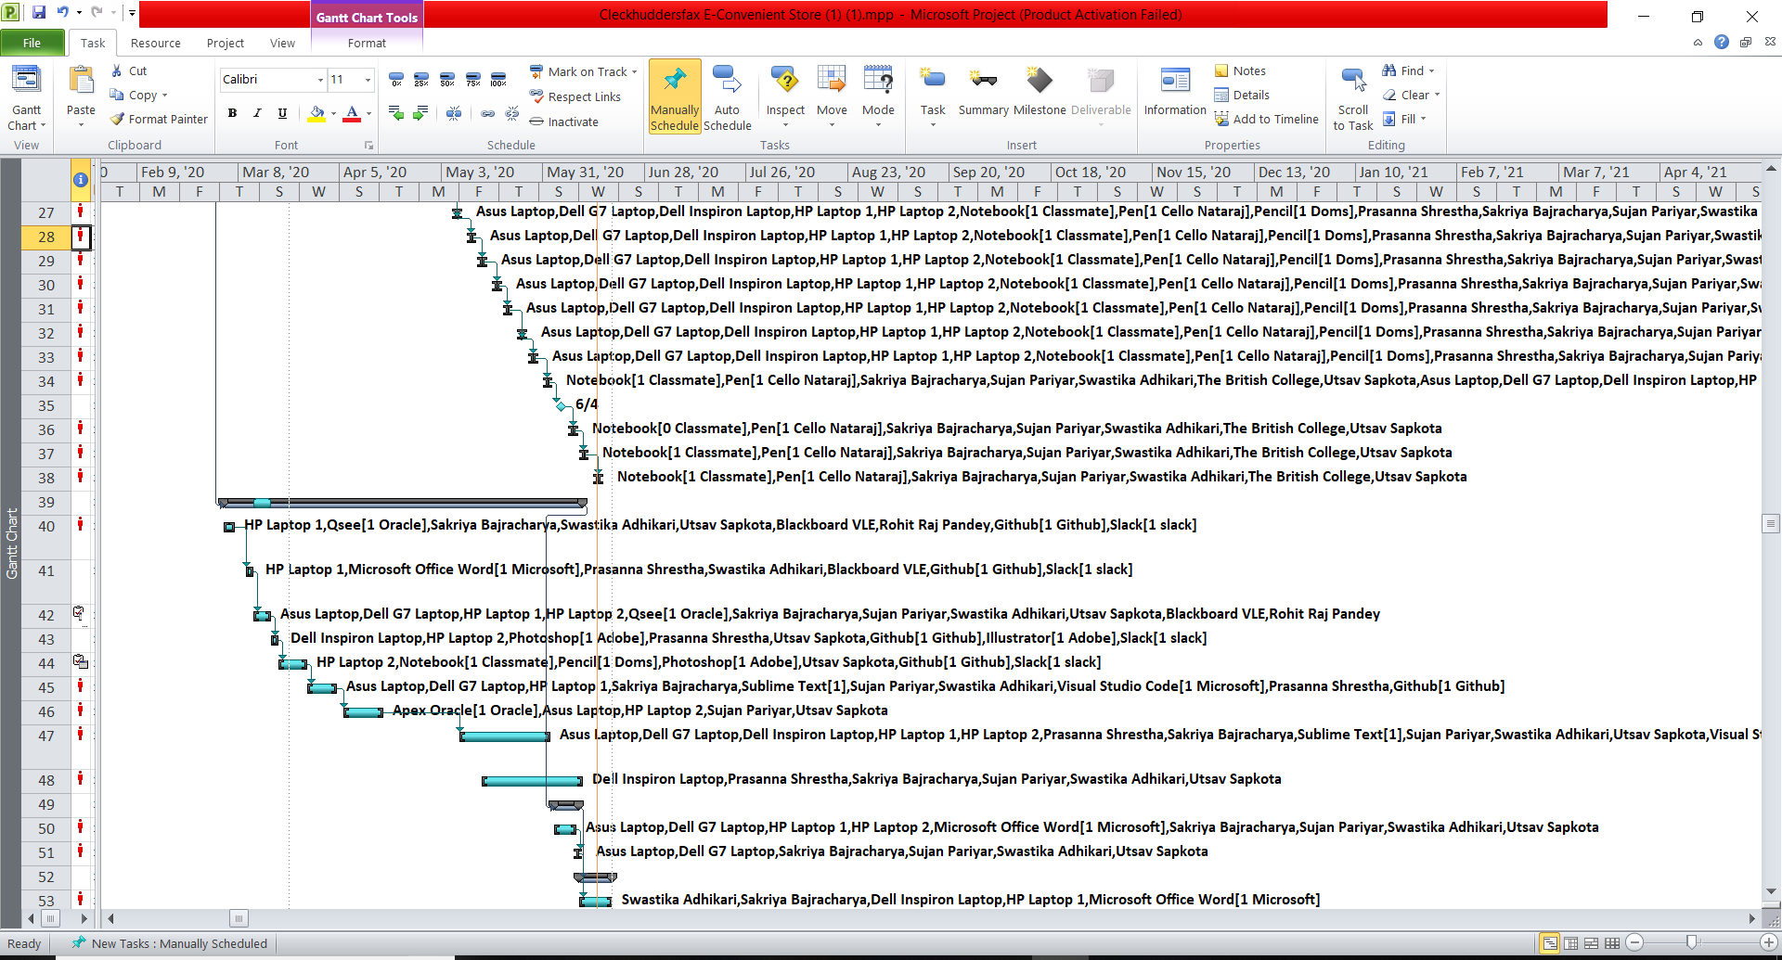
GANTT CHART SAMPLES
29

Slide 30
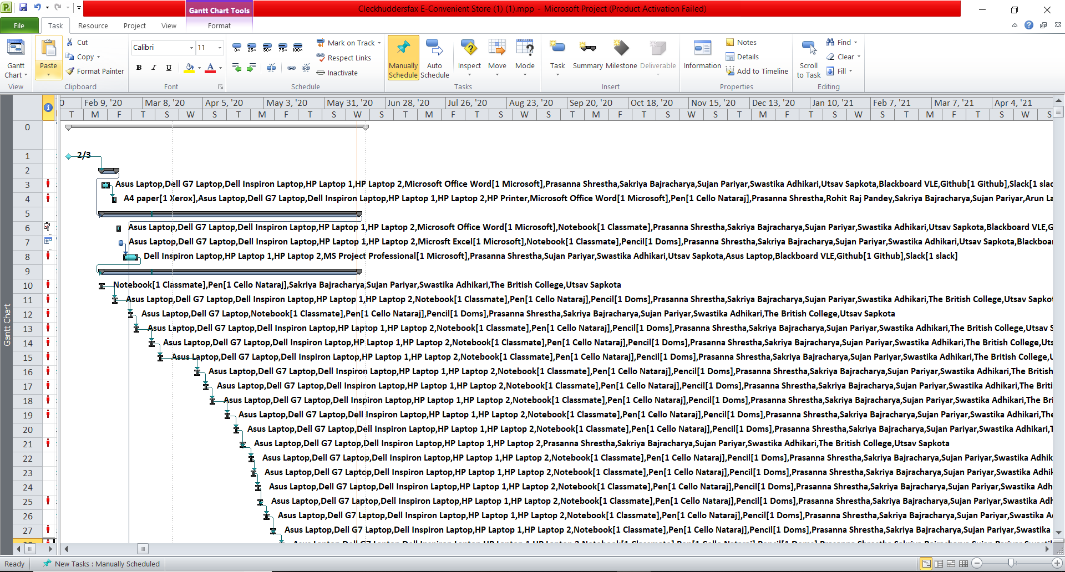
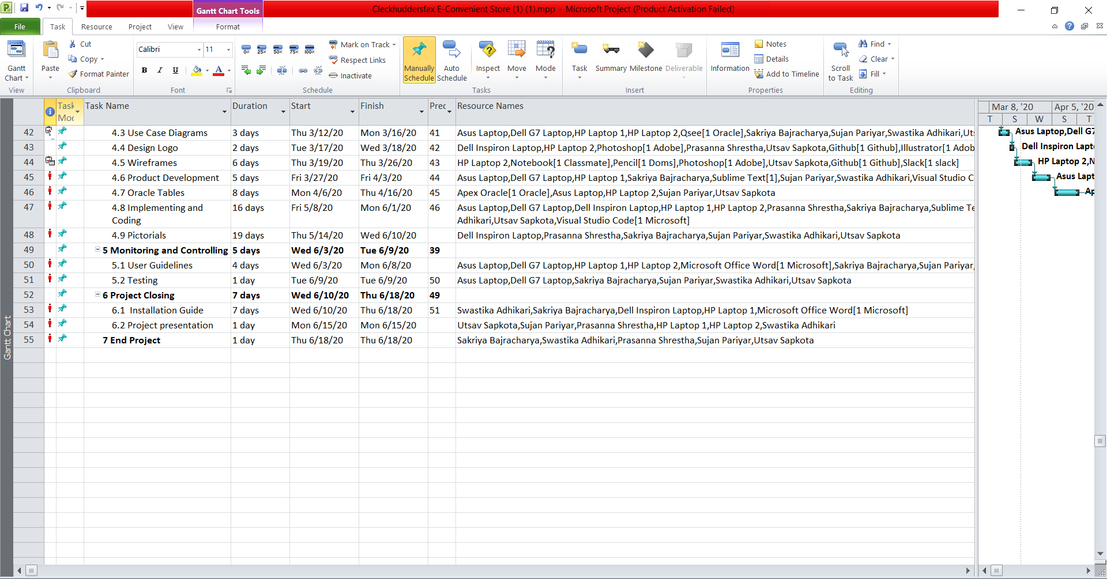
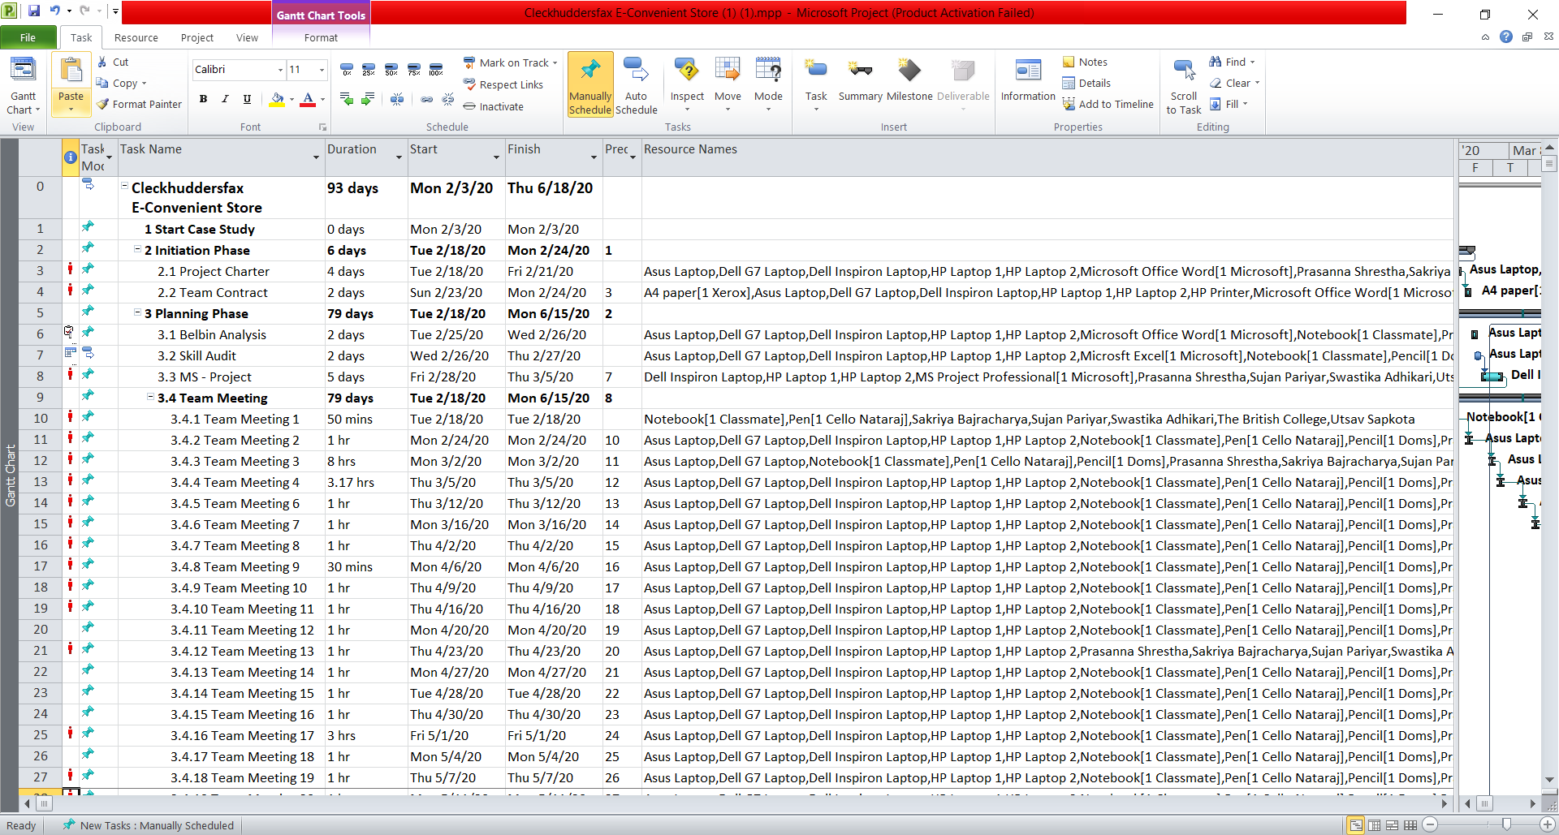
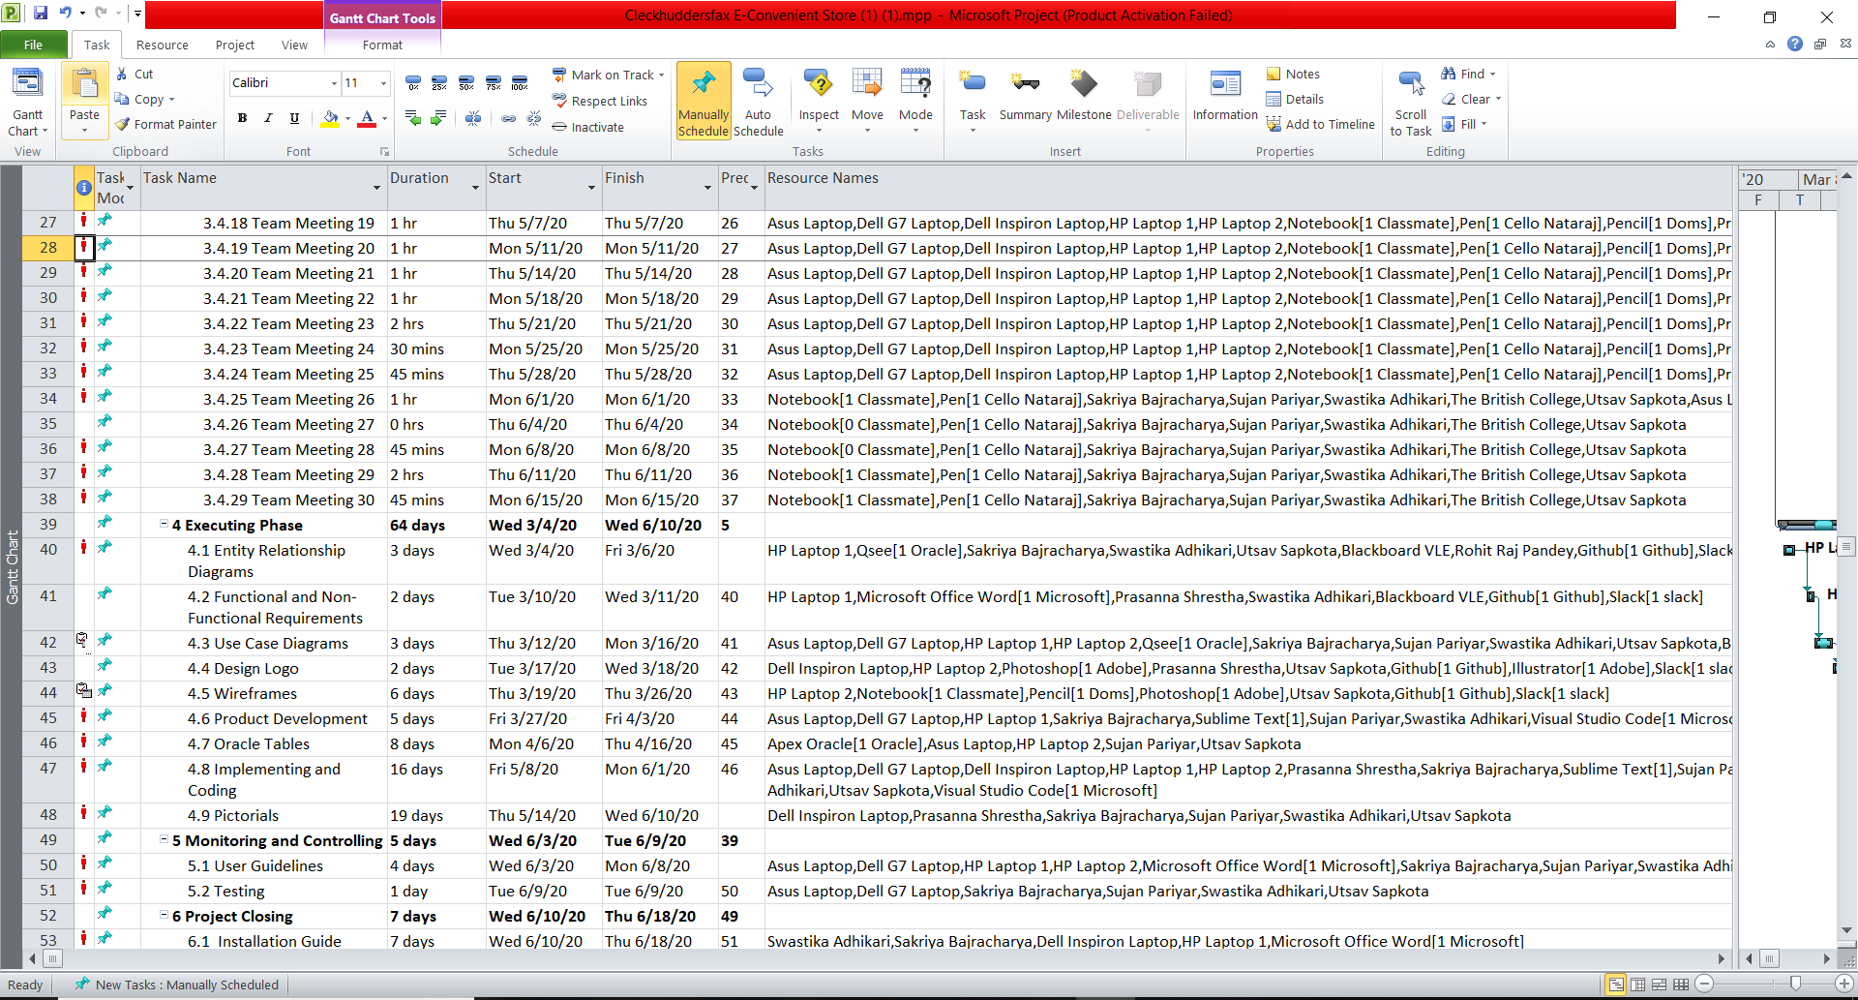
30
GANTT CHART SAMPLES

Slide 31
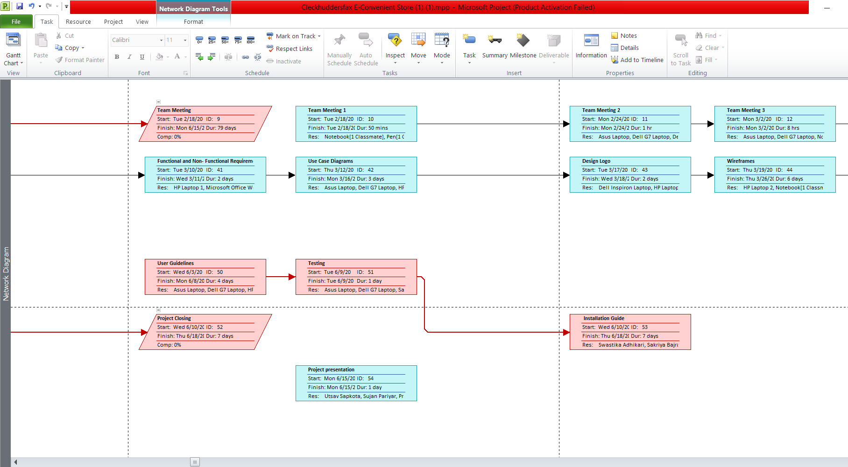
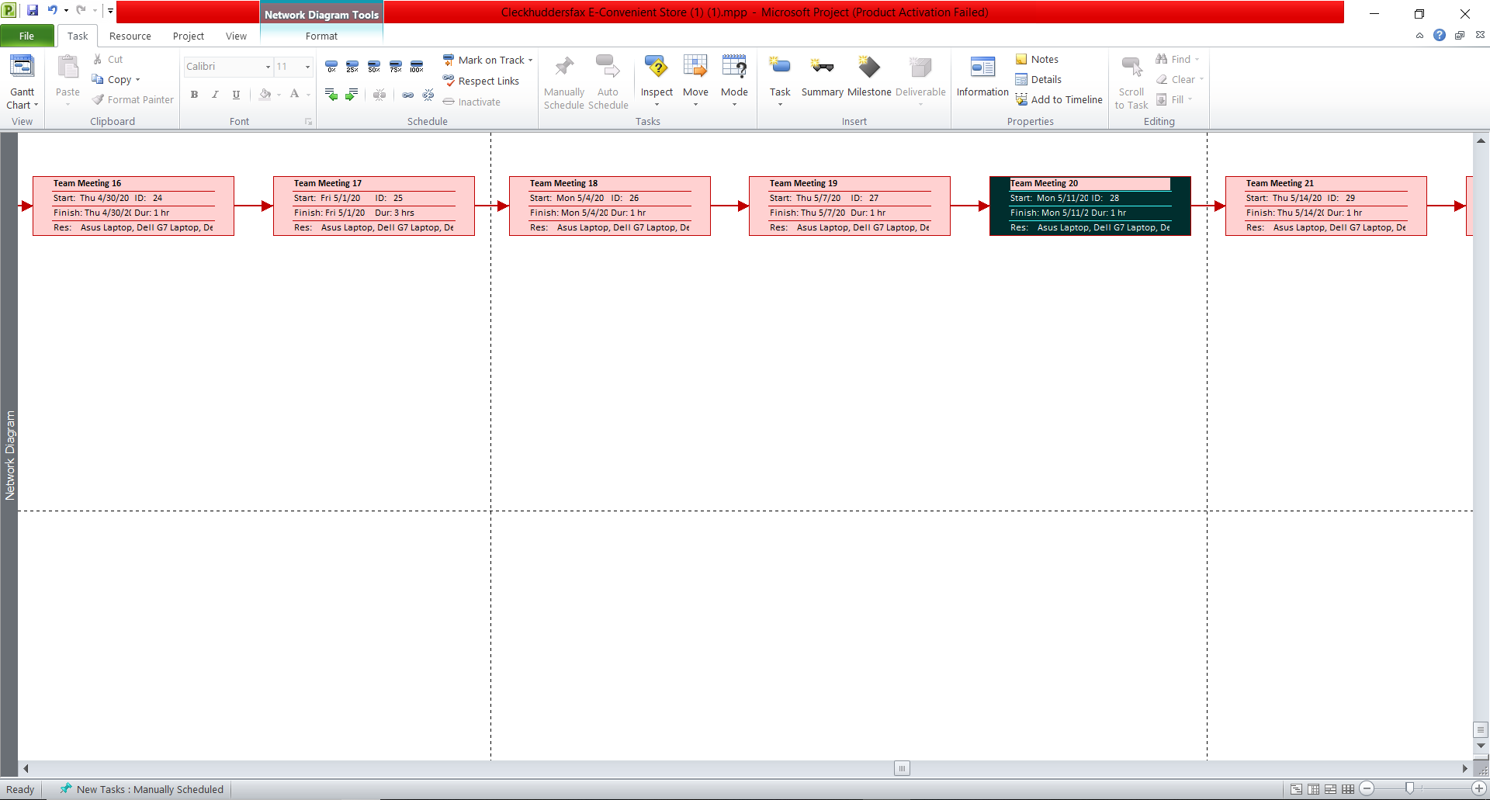
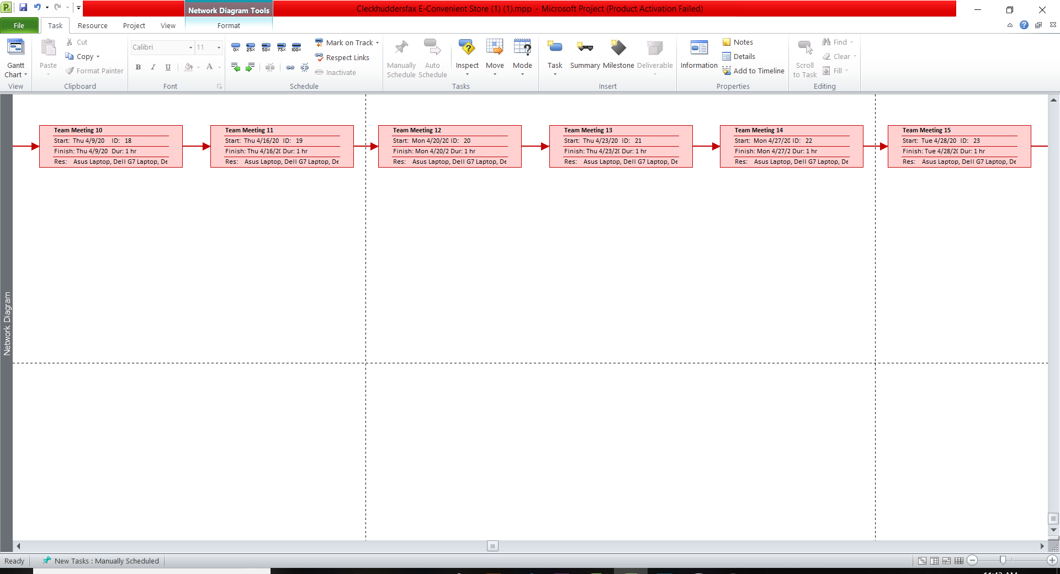
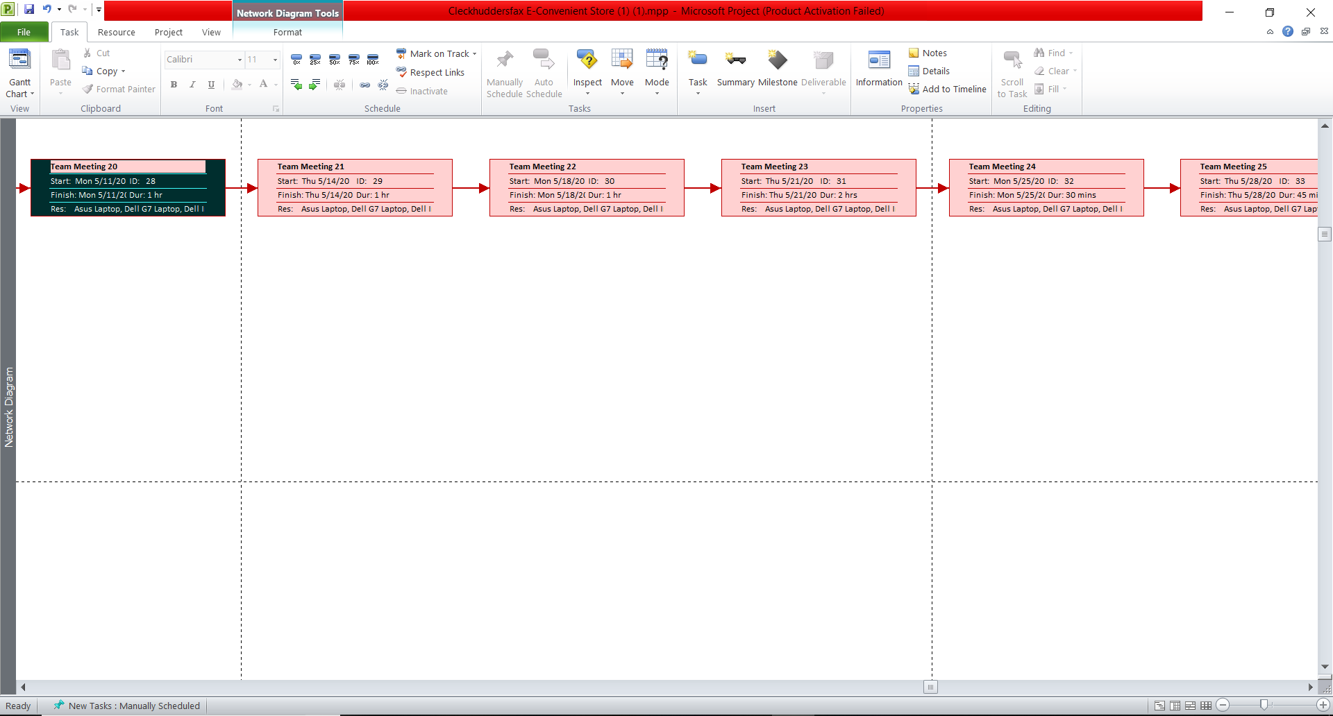
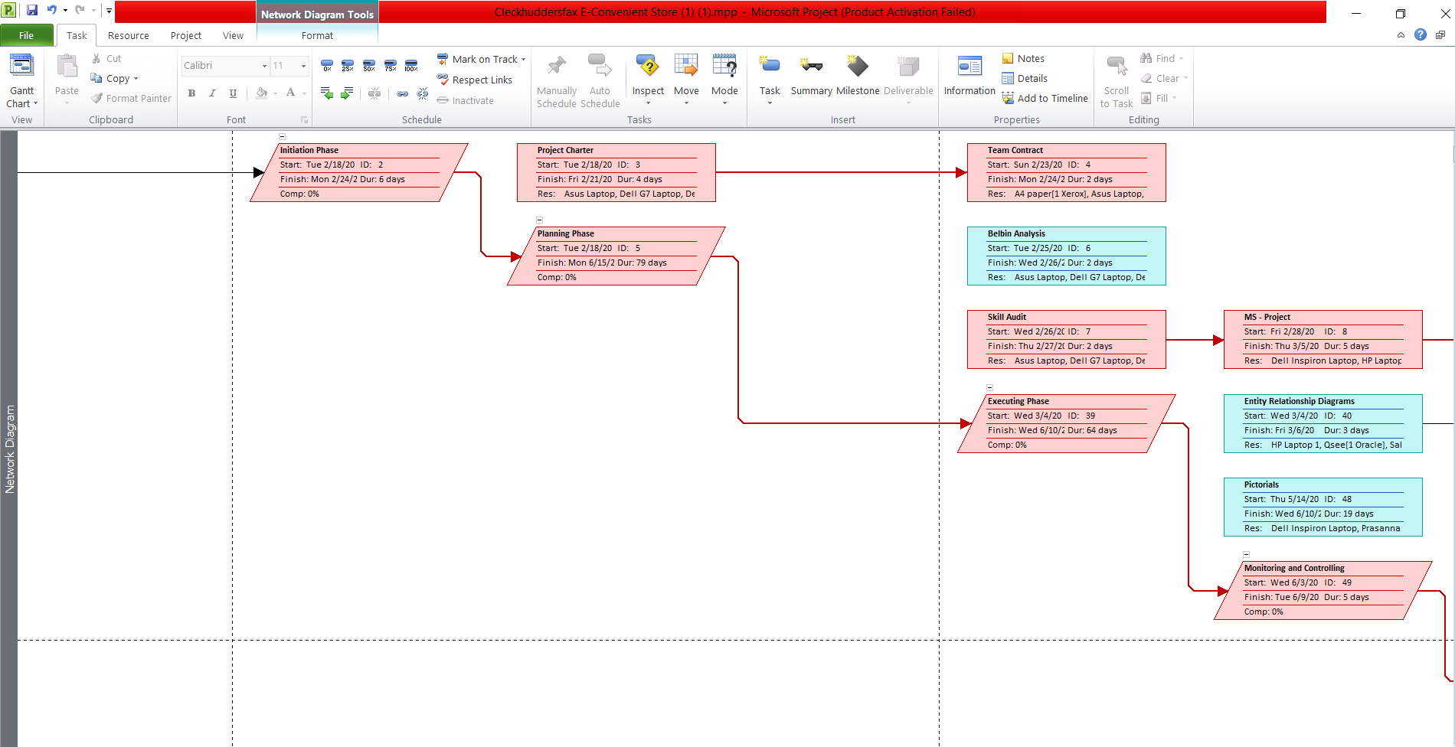
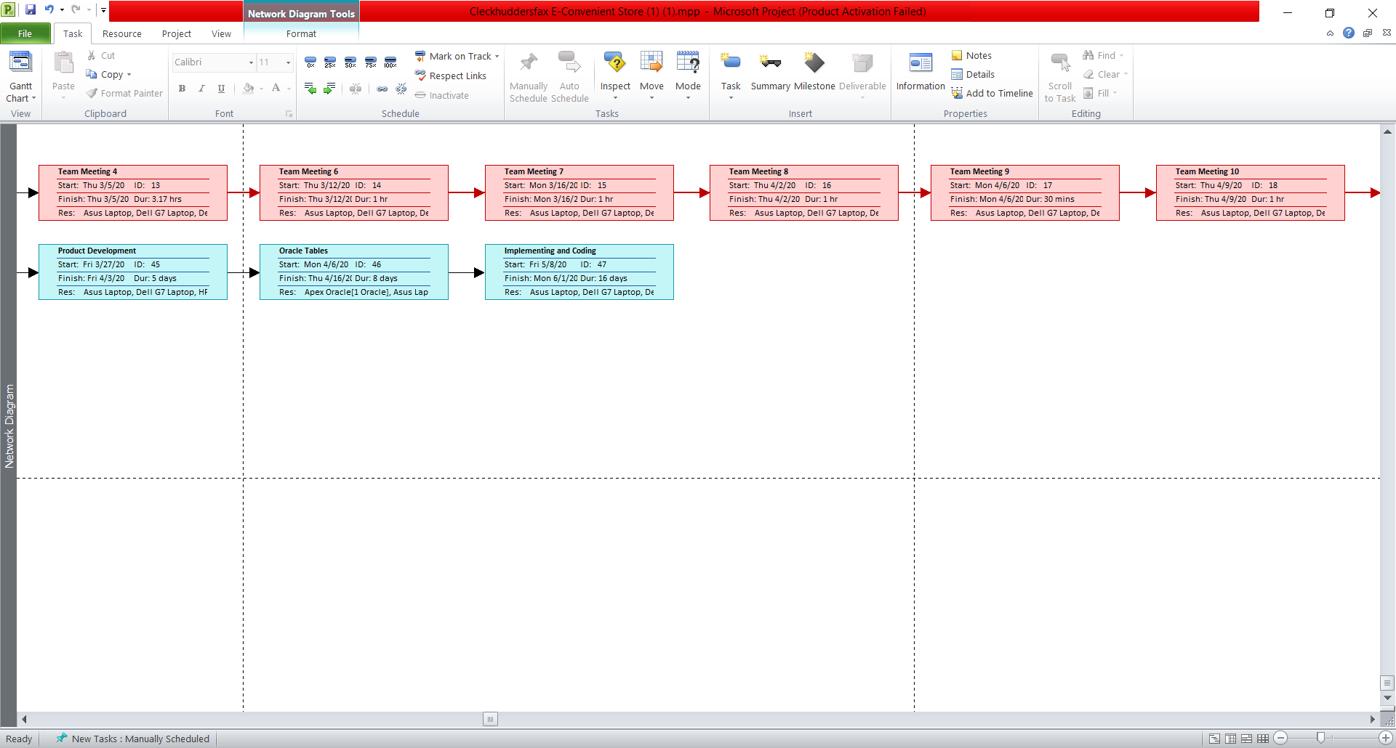
31
NETWORK DIAGRAM SAMPLES

Slide 32
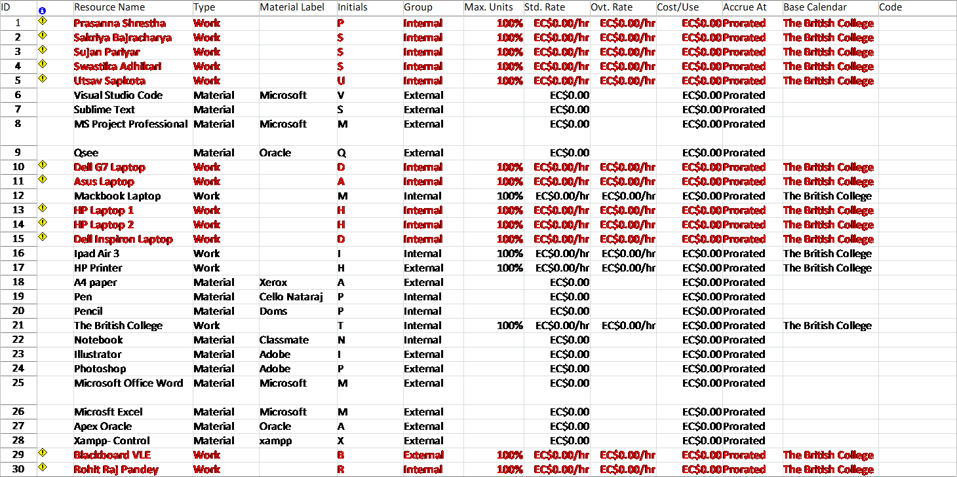
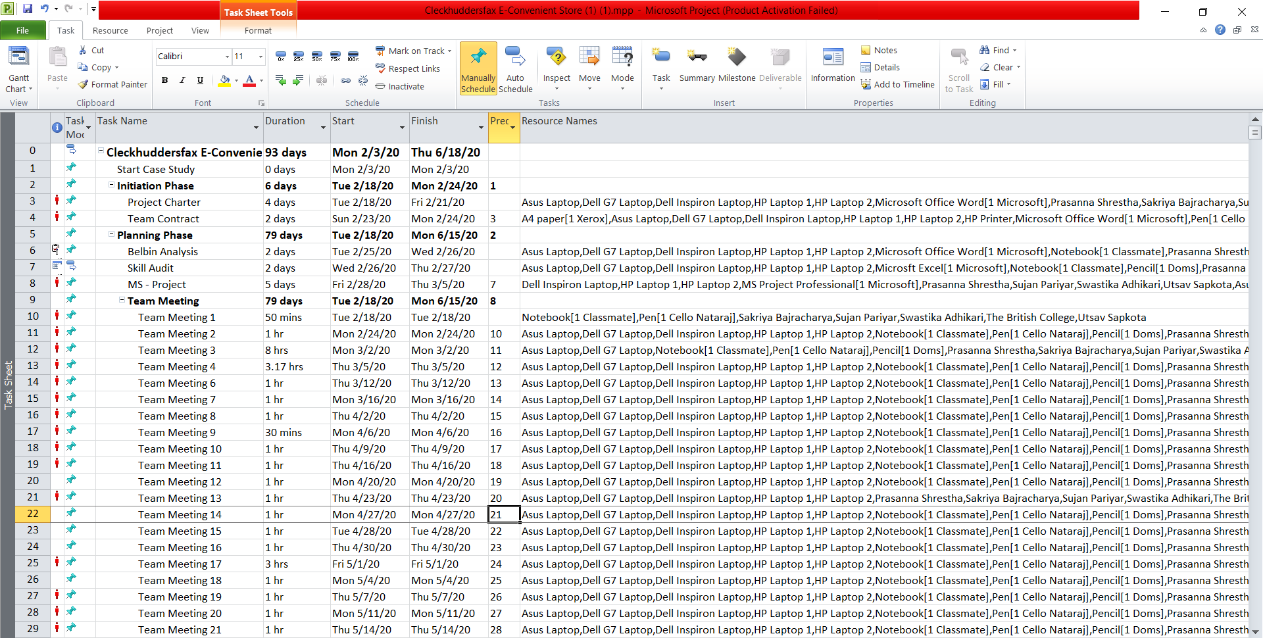
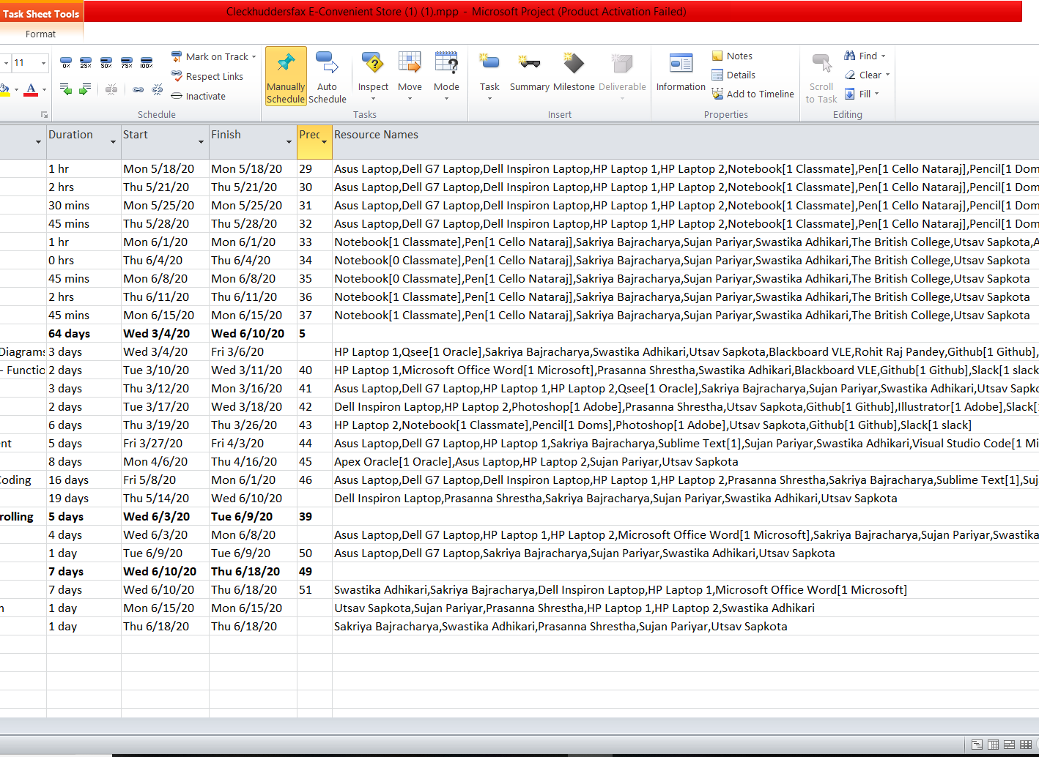
32
PROJECT TASK & RESOURCE SHEET SAMPLES

Slide 33
3rd Feb 2020
33
11th Feb 2020
Project Initiation
21st Mar 2020
21st May 2020
Project Planning
Project Executing
Project Monitoring And Controlling
19th Jun 2020
Project Closing
Project Timeline

Slide 34
Thank You !
34
Now Let’s View The Demo …

